Slide 1

Recap Week 7.
DATA ANALYTICS | IRONHACK

Slide 2
Feature Selection

Slide 3

IRONHACK BOOTCAMP
WHY FEATURE SELECTION
The objective is to improve the predictability of the model
Reduces computational complexity
Build better generalizable models
Decrease required storage

Slide 4
IRONHACK BOOTCAMP
FILTER METHODS
Filter methods are the techniques that select relevant / important features regardless of the machine learning algorithm that we are using. These filter methods can be univariate or multivariate.
Variance Threshold method - Removes features that have a variance below a threshold.
Correlation filter methods
Others

Slide 5
IRONHACK BOOTCAMP
WRAPPER METHODS
These methods use a machine learning algorithm to evaluate a subset of features. The basic process is as follows:
Select a subset of features
Build the machine learning model
Evaluate the performance
Repeat the process with a new subset of features
RFE ( Recursive Feature Elimination).

Slide 6
IRONHACK BOOTCAMP
EMBEDDED METHODS
These method perform the feature selection process while training the model. Some of the advantages of such methods are:
They are faster than wrapper methods
They take in account the relationships between features
Regularization is a technique that is used here, which basically means that we add a penalty to the cost function if we include a feature in our model that is not improving the performance.Three common regularization techniques are:
Lasso (L1 regularization)
Ridge regression (L2 regularization)
Elastic Nets

Slide 7
Feature Selection Using P-Value

Slide 8
Dimensionality reduction.
PCA
DATA ANALYTICS | IRONHACK

Slide 9
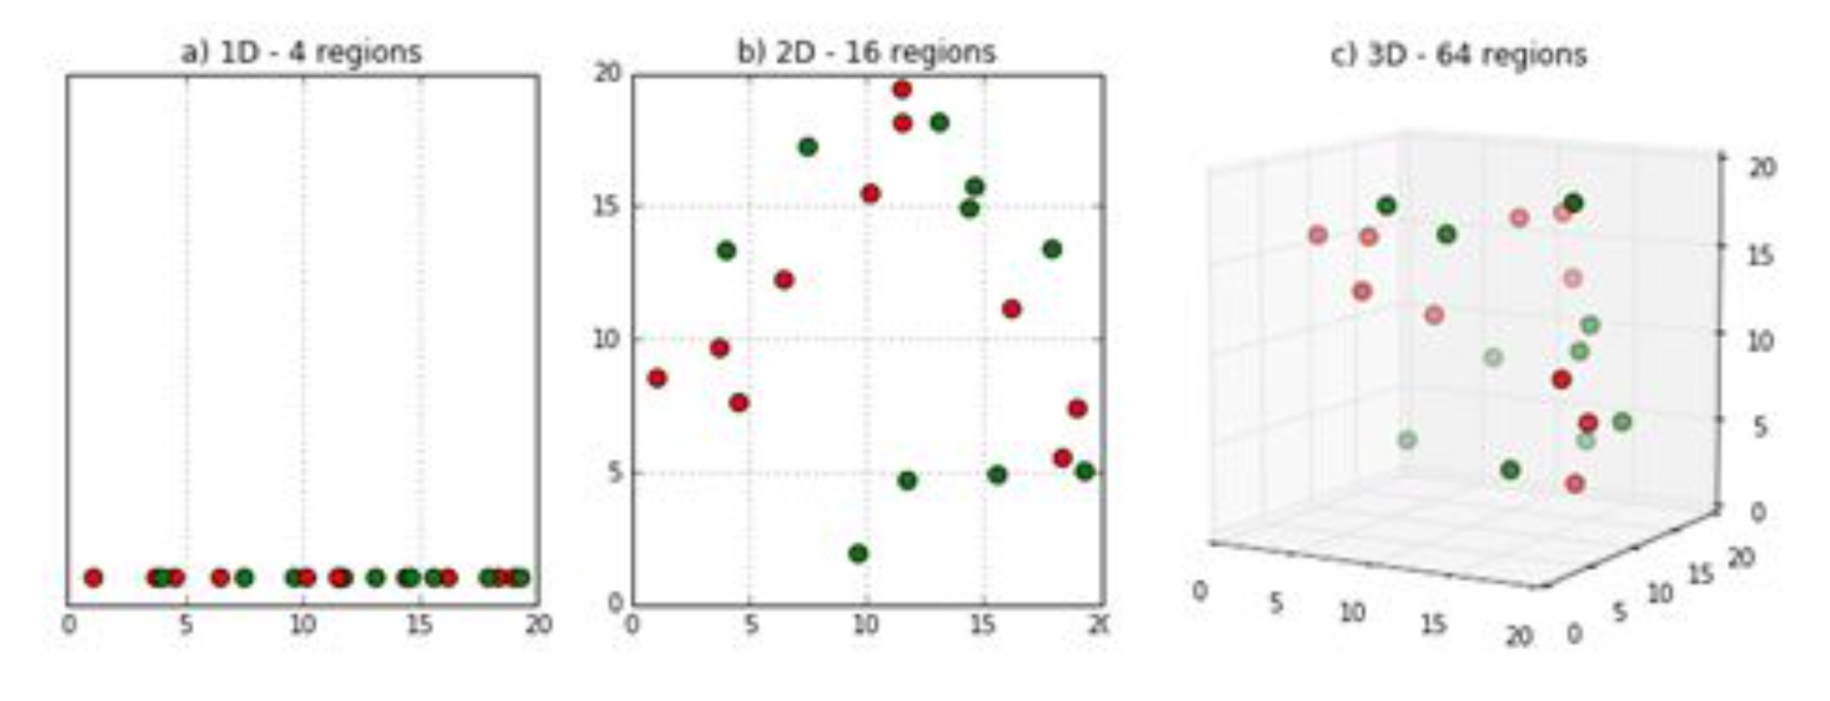
IRONHACK BOOTCAMP
CURSE OF DIMENSIONALITY
The more features, the lesser density of observations in each region of features

Slide 10
IRONHACK BOOTCAMP
THE MAIN IDEA
Switch to another set of features which capture the variability of the data.
The new dataset will have exactly the same amount of features (called principal components) than the original dataset.
Only a few principal components are retained.
The explanatory variable is not taken into account during the process!
The principal components are linear combinations of the original features

Slide 11
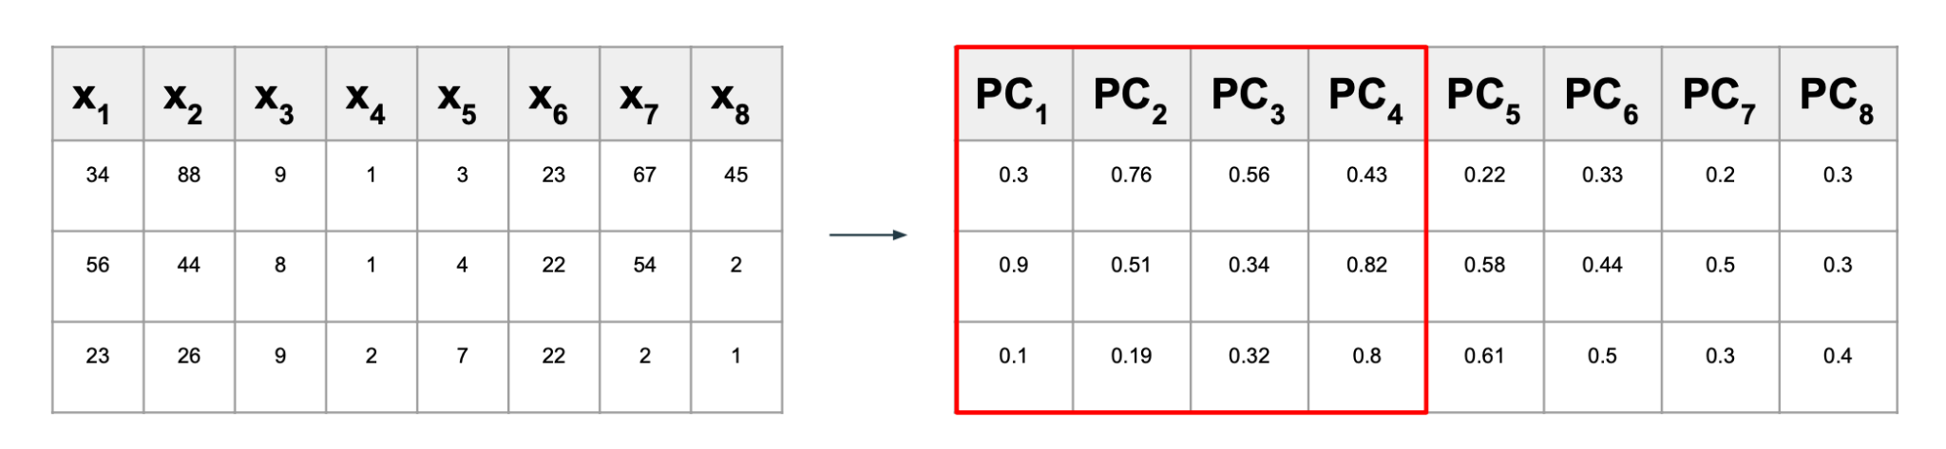
IRONHACK BOOTCAMP
THE MAIN IDEA

Slide 12
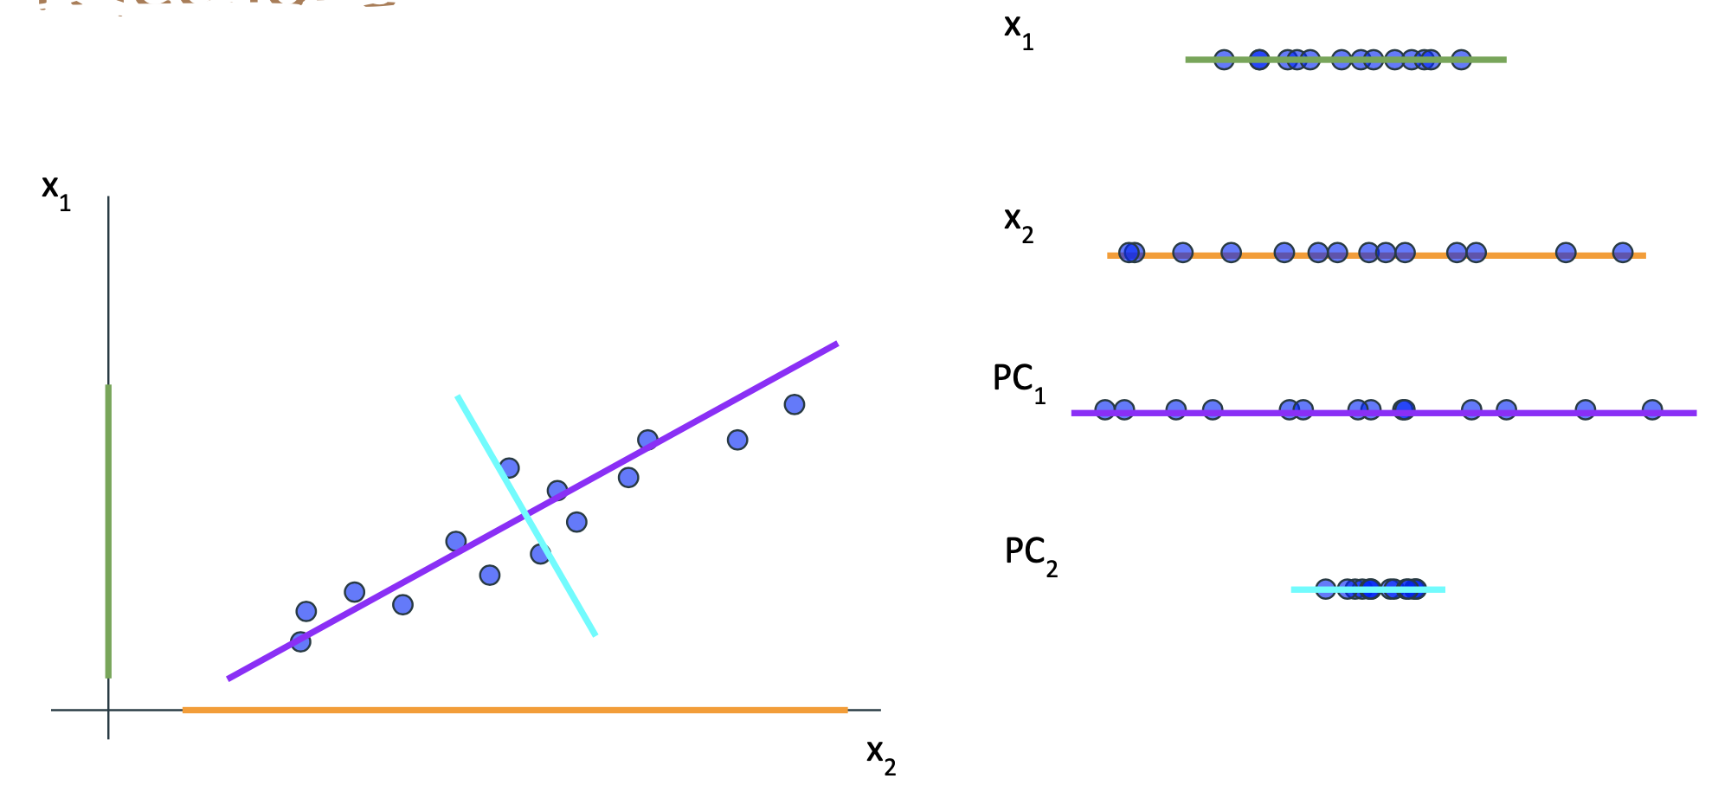
IRONHACK BOOTCAMP
THE GRAPHICAL IDEA
Rotations of the original features

Slide 13
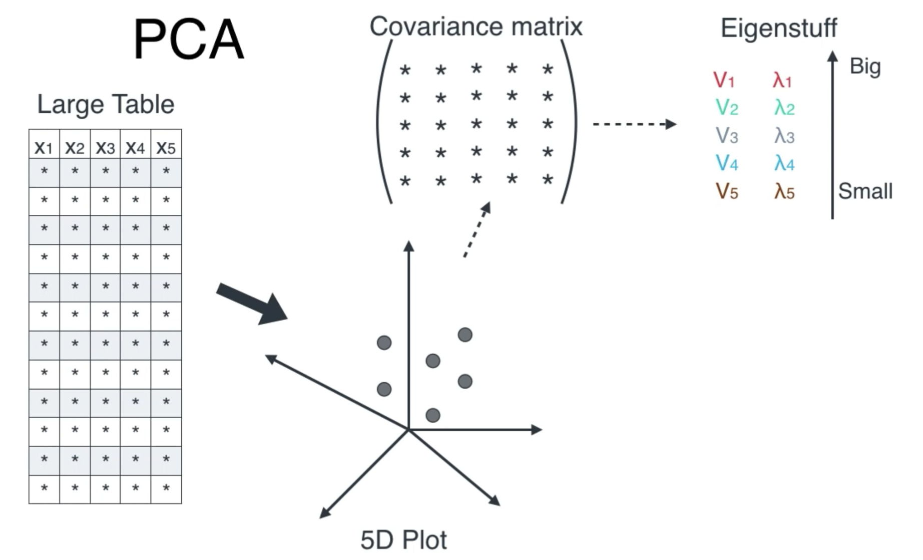
IRONHACK BOOTCAMP
DETERMINING THE COEFFICIENTS
The eigenvalues gives us the variance of each principal component.
The components of each eigenvector gives us the coefficients of each linear combination.

Slide 14
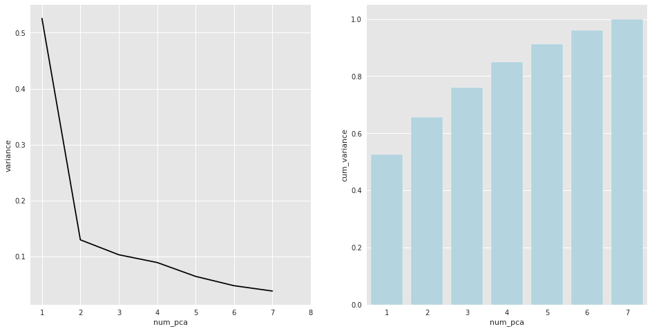
IRONHACK BOOTCAMP
HOW MANY PRINCIPAL COMPONENTS WE KEEP?
We have two possible strategies:
Scree plot ( plot the variance explained by each pca and find an elbow )
Select the number of pca’s which explain a minimum amount of the total variance. (typically 80% of the variance)
Keep in mind that if you select a subset of principal components you will not be able to explain all the data!
“The Price of Death”

Slide 15
IRONHACK BOOTCAMP
CAVEAT
There is no warranty that you will find an elbow!
Not always you will be able to explain the dependent feature with some few principal components. (The dependent feature is not taken into account during the process).
You may need to transform the features first in order to standardize them (depends on the library).
PCA in sklearn

Slide 16
The K-NN method
DATA ANALYTICS | IRONHACK

Slide 17
IRONHACK BOOTCAMP
THE BASICS OF THE K-NN METHOD
This method makes the prediction for a new observation, based on the K-Nearest Neighbours.
The “distance” between the neighbours can be anyone: Euclidean, Manhattan, Minkowski,..... The optimal one depends on the problem.
The value of K has to be provided beforehand.
The optimal value for K can be obtained by trial and error. Extreme cases are K=1, K=N = number of observations (majority vote).

Slide 18
IRONHACK BOOTCAMP
TYPES OF PROBLEMS COVERED BY K-NN
This method can deal with:
Regression (average value from the neighbours)
Classification (most frequent value from the neighbours)
The optimal value for K can be obtained plotting the error metrics of interest as a function of K..

Slide 19
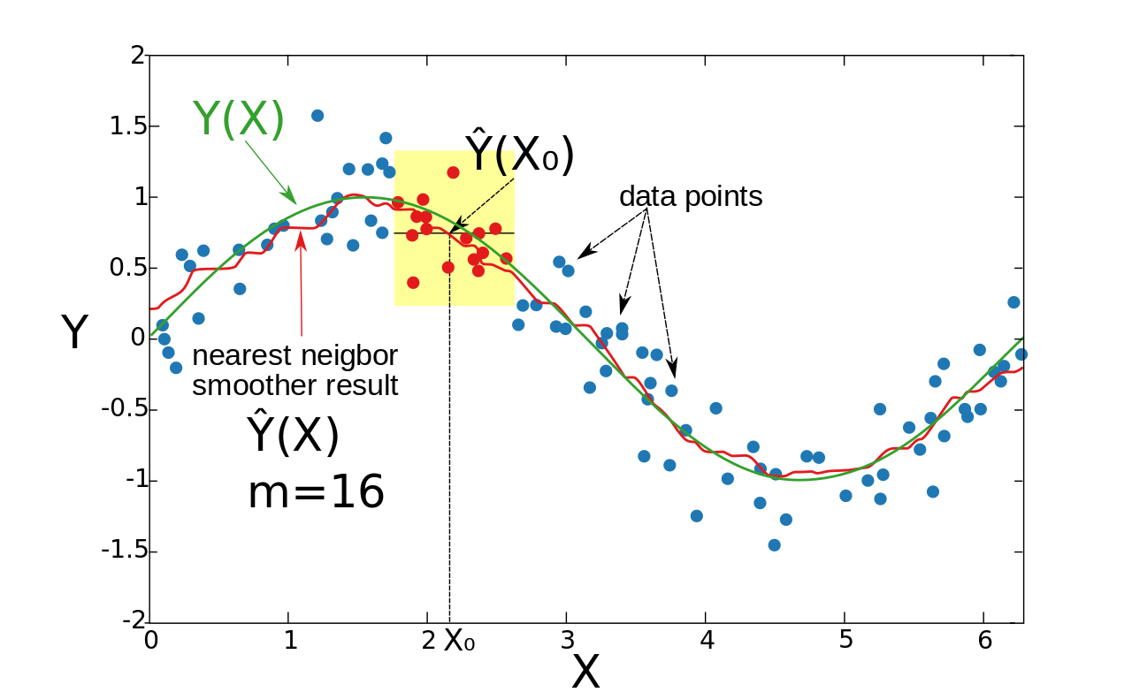
IRONHACK BOOTCAMP
K-NN METHOD FOR REGRESSION

Slide 20
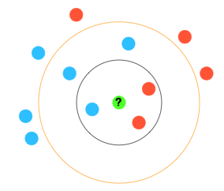
IRONHACK BOOTCAMP
K-NN METHOD FOR CLASSIFICATION

Slide 21
IRONHACK BOOTCAMP
CHOOSING THE BEST K
This model depends heavily in the values of K.
The value of K has to be provided beforehand.
We don’t know beforehand which is the value for which K value we will obtain the best performance.
We are forced to try several ones and select the one which gives us the best performance.

Slide 22

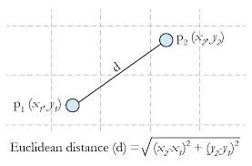
Euclidean Distance

Slide 23
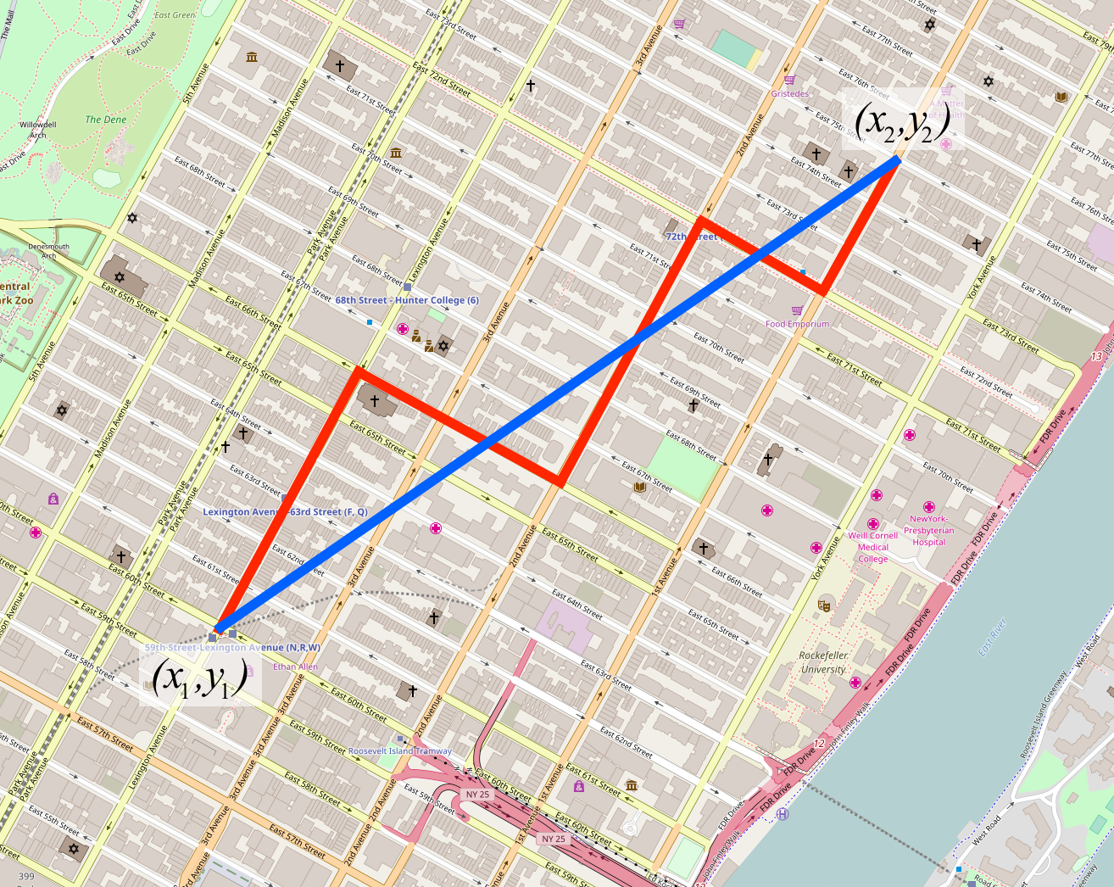
Manhattan Distance

Slide 24
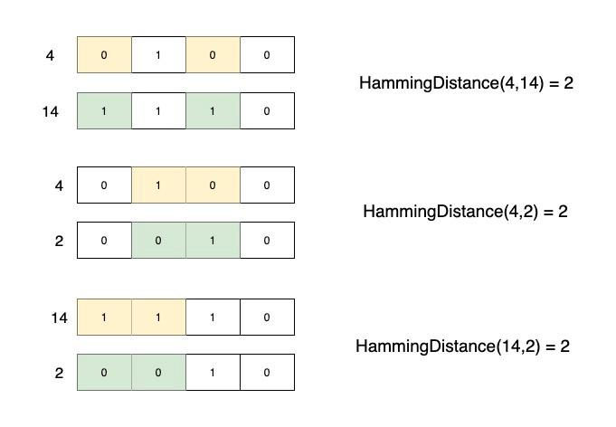
Hamming Distance
https://medium.com/geekculture/total-hamming-distance-problem-1b74decd71c9

Slide 25
Classification &
logistic regression
DATA ANALYTICS | IRONHACK

Slide 26
IRONHACK BOOTCAMP
CLASSIFICATION
Classification problems are those for which we want to predict a CATEGORICAL feature: ( color, brand, state, fraud/no fraud)
Only two possible values
Binary
Classification
More than two possible values
Multiclass

Slide 27
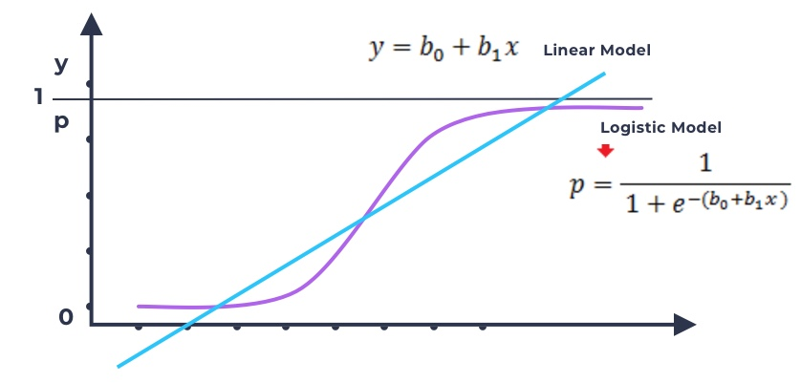
IRONHACK BOOTCAMP
BINARY CLASSIFICATION: LOGISTIC REGRESSION
P will be in the [0,1], so it can be considered as a probability of belonging to one particular class.

Slide 28
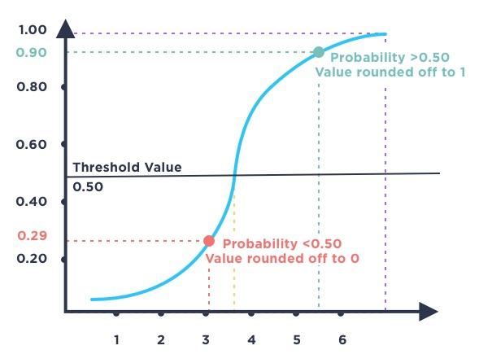
IRONHACK BOOTCAMP
DETERMINING THE PREDICTION OF THE LOGISTIC MODEL

Slide 29
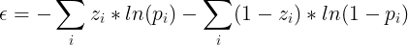
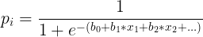
IRONHACK BOOTCAMP
DETERMINING THE LINEAR MODEL COEFFICIENTS: LOSS FUNCTION
How we can minimize the error between the prediction and the real value with a logistic regression model?
We need to find out the best coefficients to plug in the linear model in order to get the best prediction from the logistic function.
Zi is the corresponding value of a class and pi the predicted probability of belonging to a class.

Slide 30
IRONHACK BOOTCAMP
MULTICLASS CLASSIFICATION PROBLEM
Now we have more than two classes, that means that we will have more numbers than simply 0 or 1. Therefore, we can’t use the logistic model directly
DIRECT
KNN
Naïve Bayes
SVM
K class logistic regression
THROUGH BINARY CLASSIFICATION
One vs Rest (OVR)

Slide 31
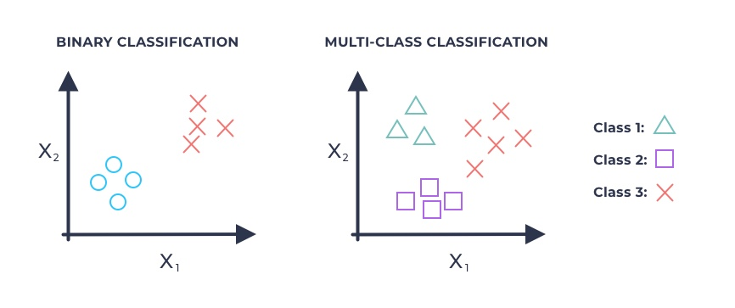
IRONHACK BOOTCAMP
One vs All (One vs Rest)
Notes:
We will see how we use the knowledge from logistic regression to solve multi class classification problem

Slide 32
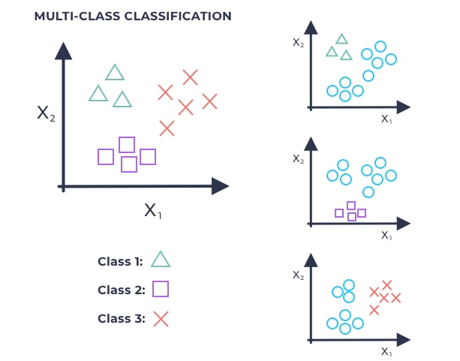
IRONHACK BOOTCAMP
One vs All (One vs Rest)
*Break down the problem into
three binary classification problems

Slide 33
Decision Trees
DATA ANALYTICS | IRONHACK

Slide 34
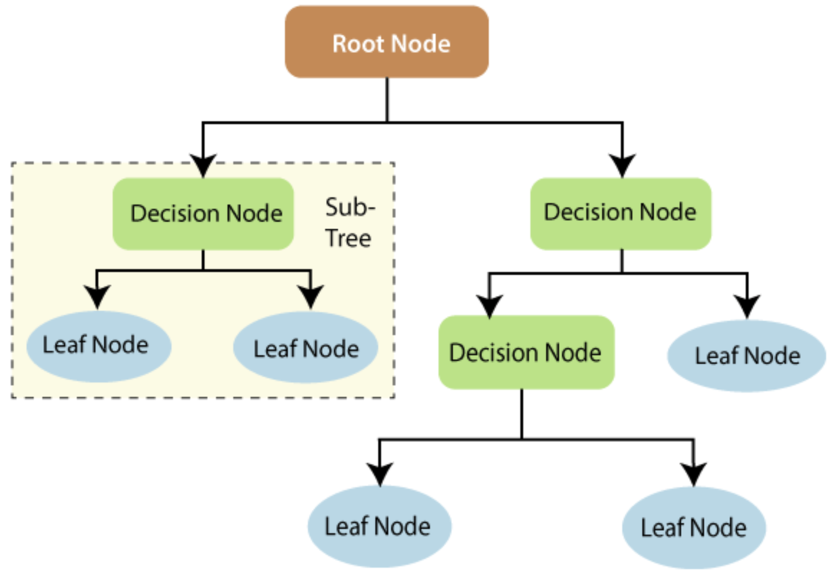
IRONHACK BOOTCAMP
DECISION TREES
Decision trees are another type of machine learning models which can be used for regression and classification problems.
They work with splitting or segmenting the predictor space into a number of binary decisions to make the prediction.
The decisions are selected in order to minimize the variance of the observations in each leaf.
Decision trees do not need feature scaling!!! -> No transformers needed.

Slide 35
IRONHACK BOOTCAMP
DECISION TREES PARAMETERS
Depth: number of nodes to reach the bottom leafs
Minimum samples leaf: minimum number of samples in a leaf.
Minimum samples split: minimum number of samples in decision node in order to try splitting further
Max_features: maximum number of features to consider for split.

Slide 36
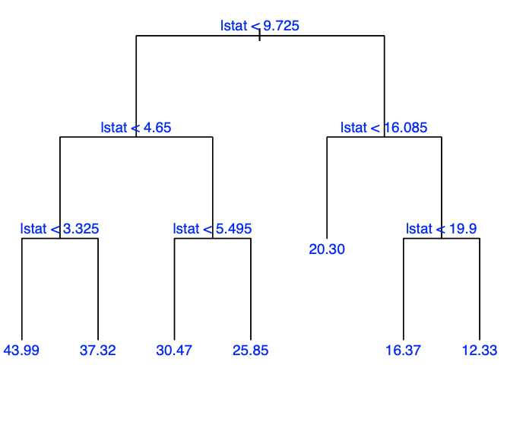
IRONHACK BOOTCAMP
DECISION TREES FOR REGRESSION (I)
Here we will take the example of boston housing data as it is a simpler regression problem.
The objective was to predict the value of a house (in x 10 K)
To simplify we will take a look at only one feature "lstat"
A decision rule to make the prediction is shown on the figure:

Slide 37
IRONHACK BOOTCAMP
DECISION TREES FOR REGRESSION (II)
After we train the model, the set of bottom nodes in the decision tree gives us the partition of the feature space into disjoint regions.
For each region, we calculate the average of the target variable falling in that region of the training data. That gives us the numerical prediction value

Slide 38
IRONHACK BOOTCAMP
DECISION TREES FOR CLASSIFICATION
Classification trees work in the same way as the regression trees except that the final prediction is the most frequent class in each leaf node.
They try to create leaf nodes which have the most of the observations of one class in order to make less mistakes.
Split 1
Split 2
Splitting 1 is preferred over splitting 2 because the majority of the balls are of one color

Slide 39
IRONHACK BOOTCAMP
PROS AND CONS OF DECISION TREES
PROS | CONS
Pretty fast providing a prediction | They can’t predict any numerical value bigger than the values present in the train set. They can’t predict any categorical value which is not present in the train set. Their prediction is the majority class or the mean value of the leaf node.

Slide 40
EVALUATING A CLASSIFICATION MODEL

Slide 41
IRONHACK BOOTCAMP
EVALUATING A CLASSIFICATION MODEL
How we can evaluate the model?
Now we have labels instead of numbers!
We can’t simply compare numbers.

Slide 42
IRONHACK BOOTCAMP
CONFUSION MATRIX
Real
Positive
Negative
You can display the confusion matrix using sklearn plot_confussion_matrix
However, be aware that sklearn exchanges rows and columns!
Positive
TP
FP
Predicted
Negative
FN
TN

Slide 43

IRONHACK BOOTCAMP
CONFUSION MATRIX
Real
Positive
Negative
If you are deemed to fail what kind of error do you prefer to make?
Positive
TP
FP
Type I error
Predicted
Negative
FN
TN
Type II error

Slide 44
IRONHACK BOOTCAMP
CONFUSION MATRIX
Real
Positive
Negative
Accuracy = (TP+TN)/(TP+TN+FP+FN)
Positive
TP
FP
Precision = (TP)/(TP+FP)
Type I error
Recall = (TP)/(TP+FN)
Predicted
F1 = 2 *(Precision*Recall)/(Precision + Recall)
Negative
FN
TN
Type II error

Slide 45

Bias/Variance Trade-off
DATA ANALYTICS | IRONHACK

Slide 46
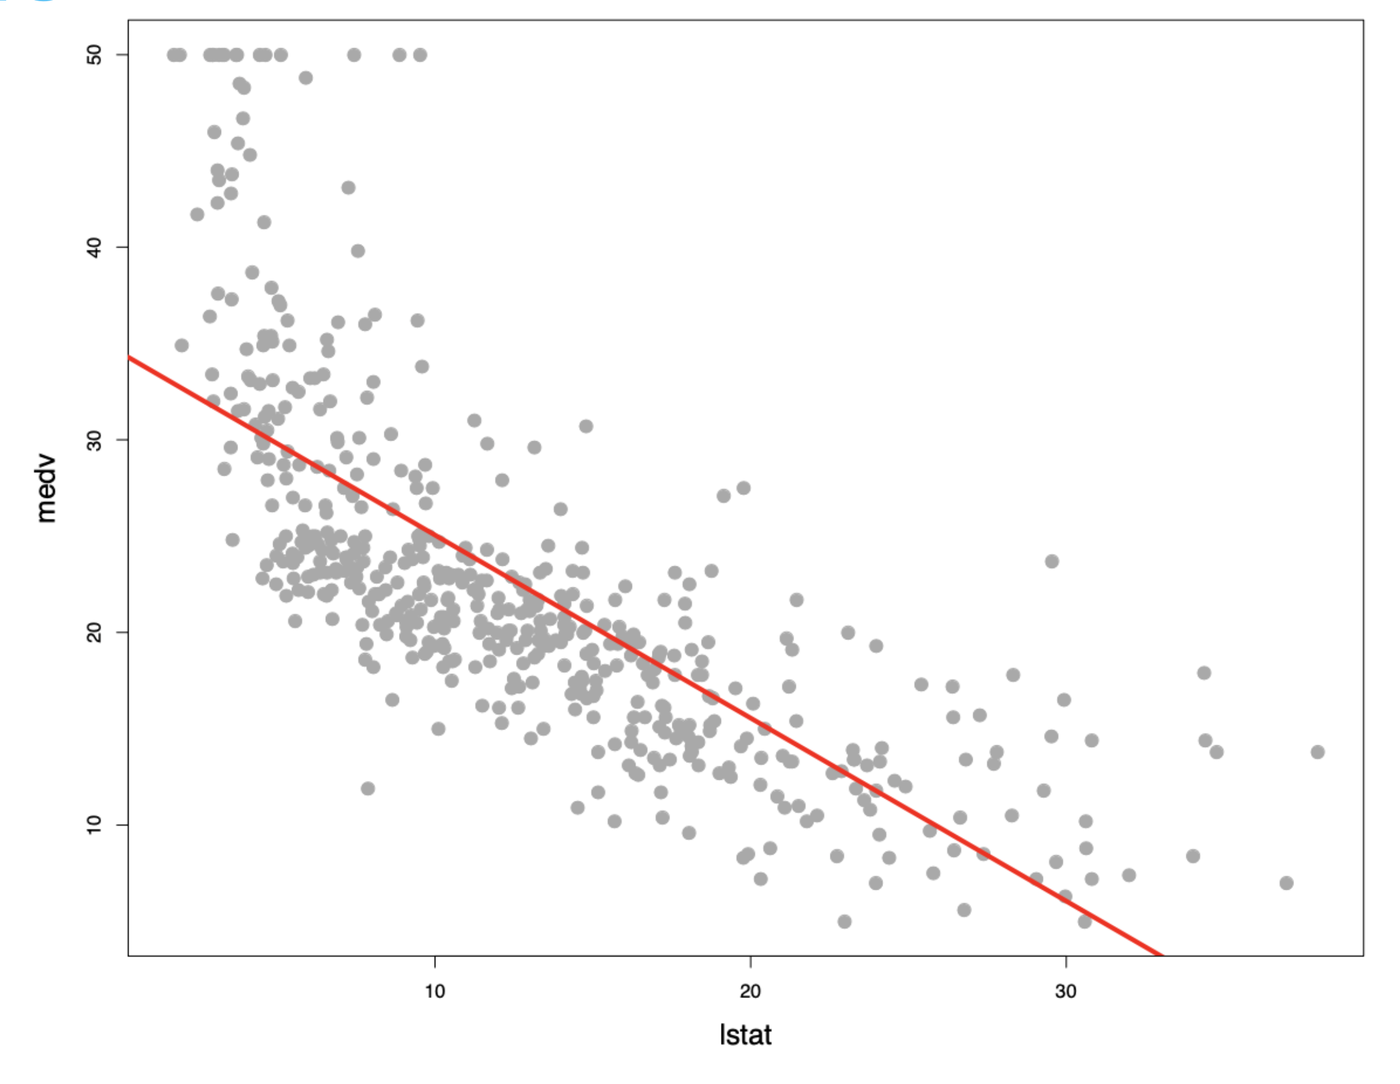
IRONHACK BOOTCAMP
Using Linear Regression To Predict Median House Value

Slide 47
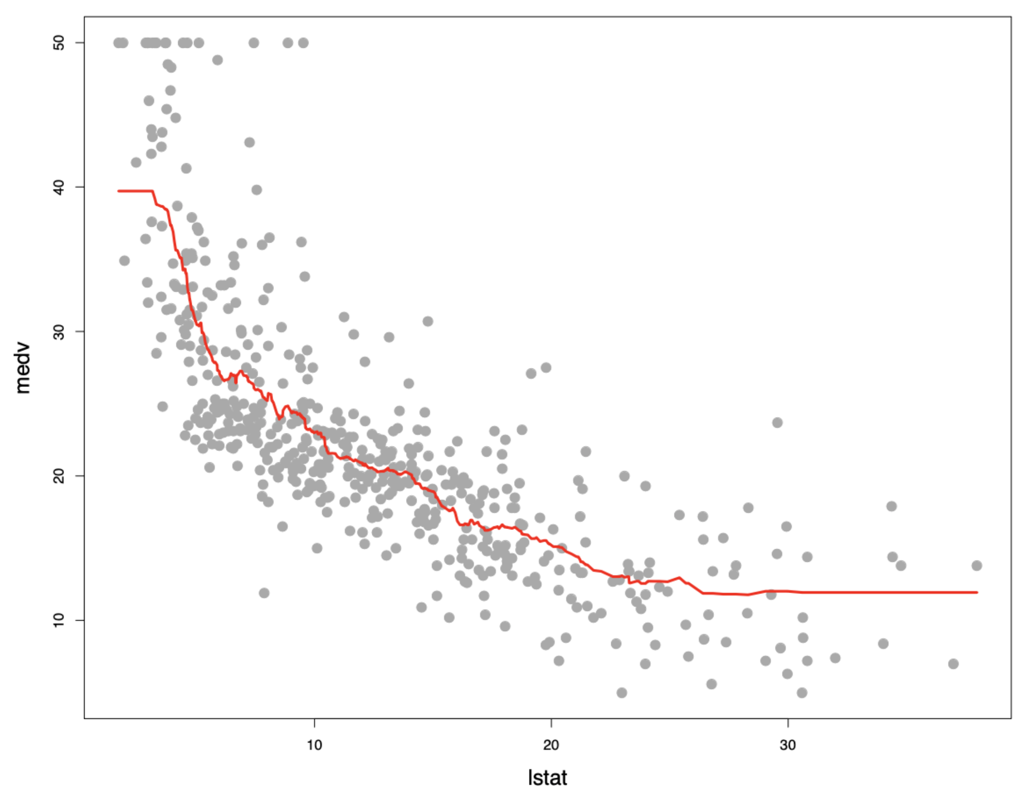
IRONHACK BOOTCAMP
Using KNN To Predict
Median House Value

Slide 48

🤹🏽
BIAS / VARIANCE trade-off

Slide 49
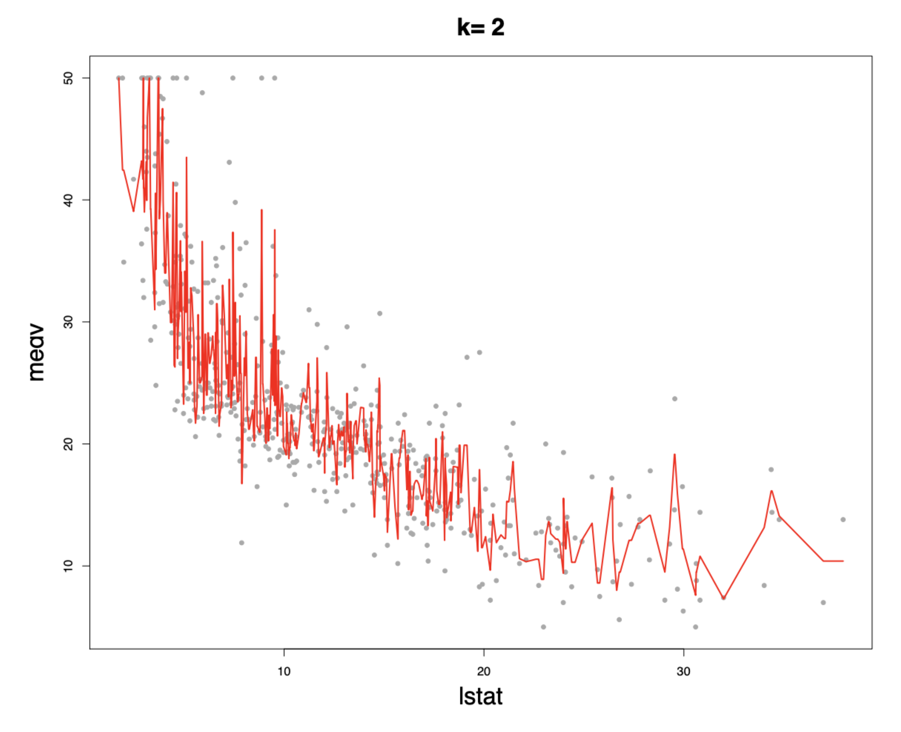
IRONHACK BOOTCAMP
BIAS/VARIANCE Trade-off
Prediction line is following
very closely with the training data.
There is very high variance
Bias is very low
as there is less difference
between actual and predicted value

Slide 50
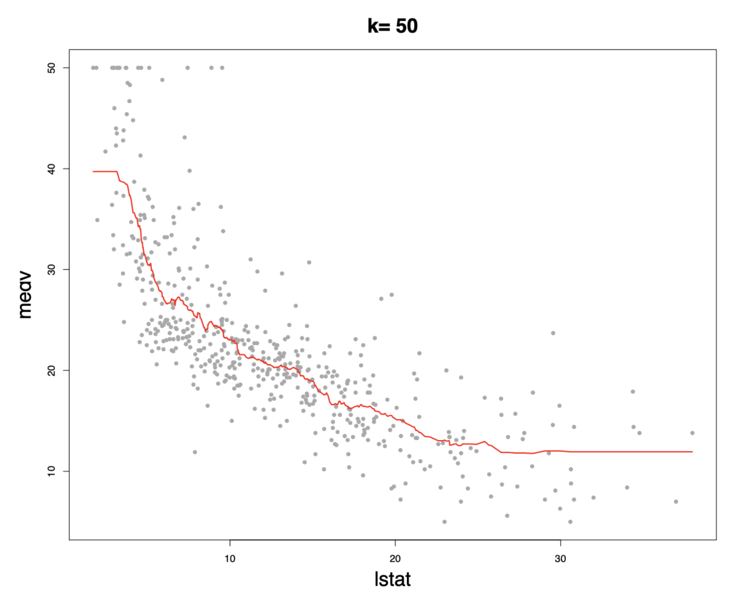
IRONHACK BOOTCAMP
BIAS/VARIANCE Trade-off
Prediction line is following
the training data but
not as much as the previous case.
Variance is a lot lower
than the previous case

Slide 51
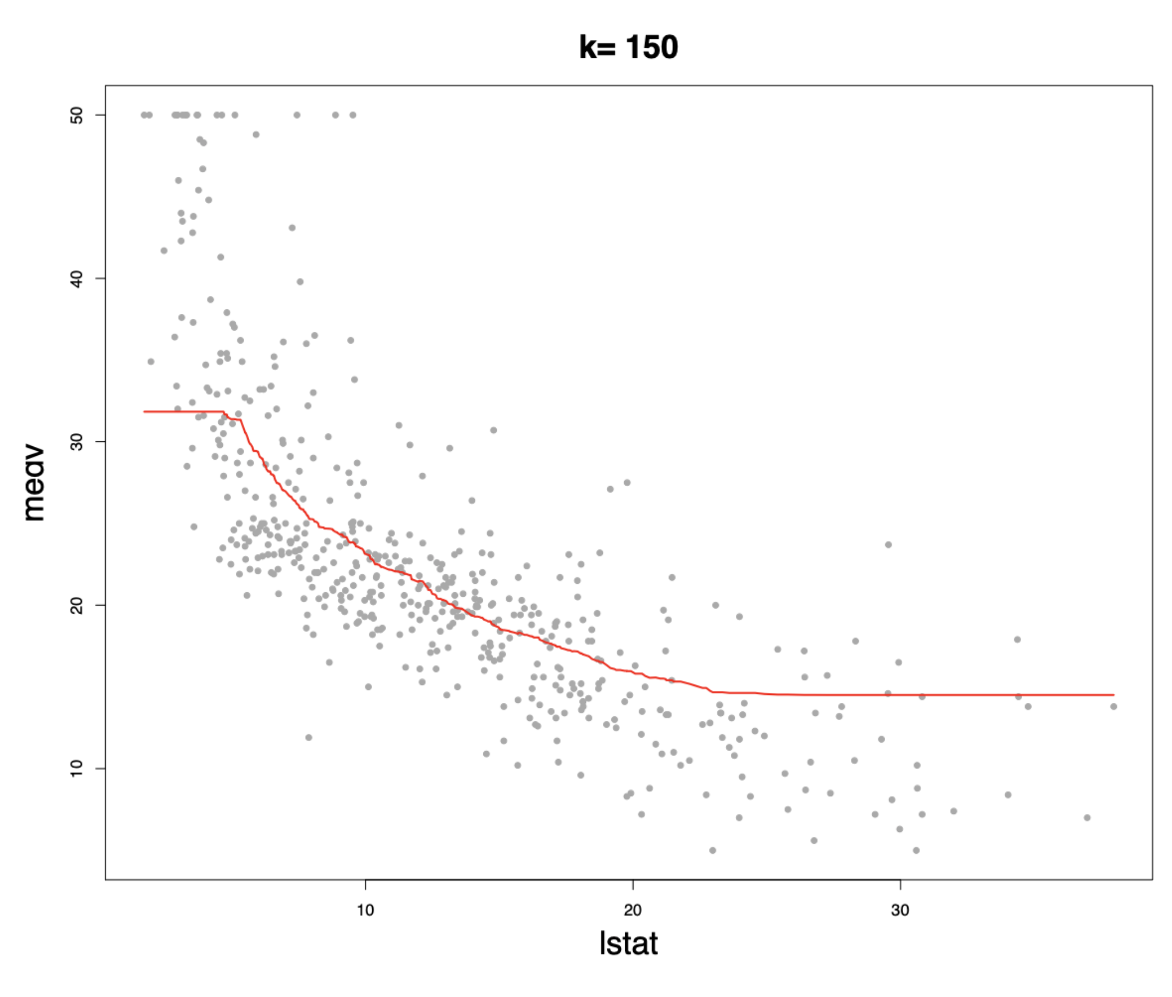
IRONHACK BOOTCAMP
BIAS/VARIANCE Trade-off
Prediction line is following
the training data quite loosely.
Variance is lower
than the previous case
but bias is increasing

Slide 52
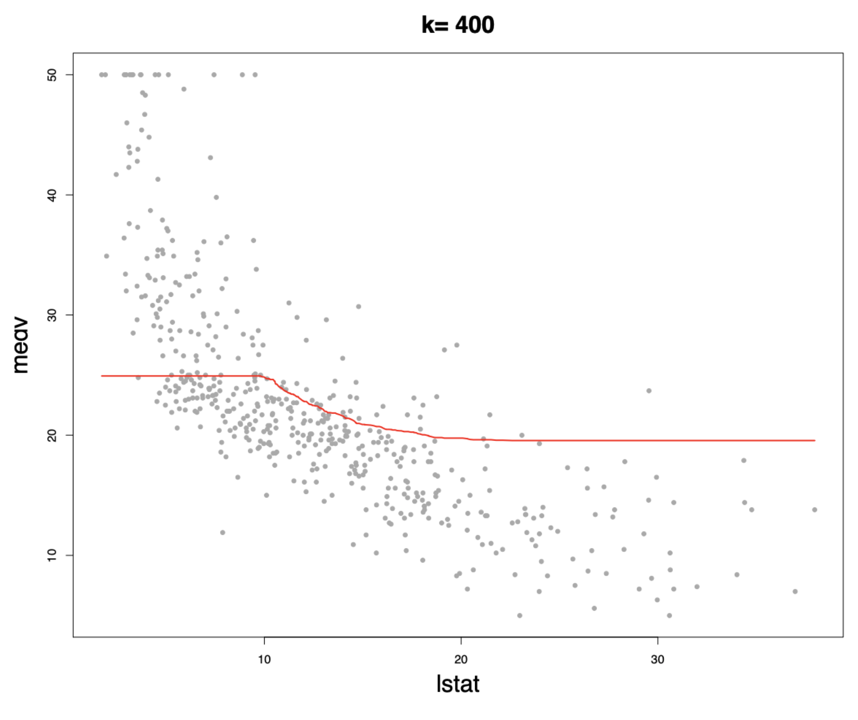
IRONHACK BOOTCAMP
BIAS/VARIANCE Trade-off
Prediction line is following
the training data even more loosely.
While variance is slightly lower
than the previous case,
bias is increasing.

Slide 53
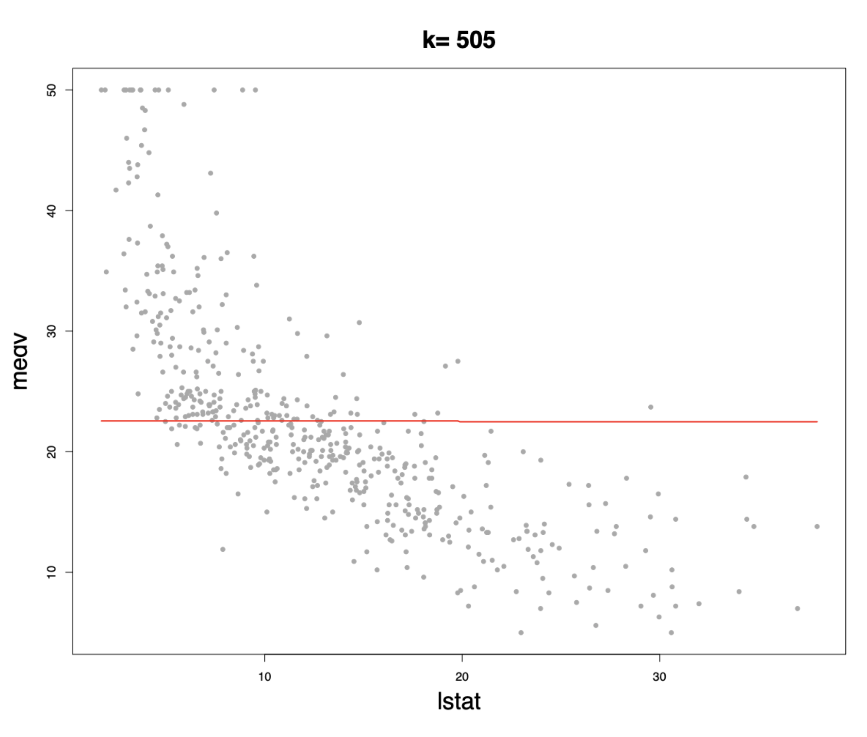
IRONHACK BOOTCAMP
BIAS/VARIANCE Trade-off
No variance
but
very high bias

Slide 54

Source: http://scott.fortmann-roe.com/docs/BiasVariance.html

Slide 55
IRONHACK BOOTCAMP
NOT TOO SIMPLE, BUT NOT TOO COMPLEX

Slide 56
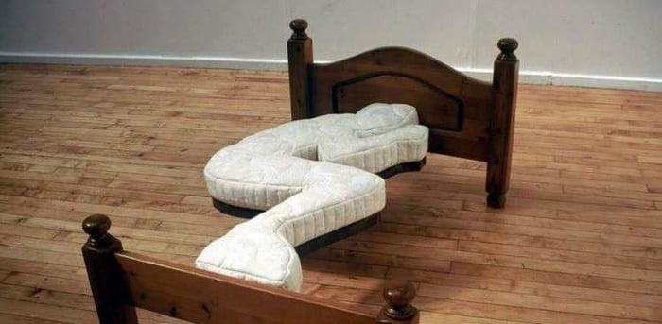
IRONHACK BOOTCAMP
NOT TOO SIMPLE, BUT NOT TOO COMPLEX

Slide 57
Cross Validation.
DATA ANALYTICS | IRONHACK

Slide 58
SAMPLING EFFECTS
Every time we make a random selection to train a model, we will get a different dataset.
Every dataset will produce a different model.
How we can evaluate the sensitivity of our model to the sample we took?
Some methods have an internal seed, therefore, even with the same split they will produce different models!

Slide 59
EVALUATING SAMPLING EFFECTS
To estimate the effect of the sample in the model, we can use two strategies:
Leave one out cross validation
K-fold cross validation

Slide 60
LEAVE ONE OUT CROSS VALIDATION (I)
This technique takes the training set and trains as many “subrogate” models as existing observations in the train set.
However, while training every “subrogate model” one of the observations is left out from training, and used as “test” set.
The left out observation is different each time.
Train set
Test set
Real model
SM1
K = N_train
SM2

Slide 61
IRONHACK BOOTCAMP
LEAVE ONE OUT CROSS VALIDATION (II)
The final model performance is estimated as the “mean” performance of all the SM models.
The variance of the final model performance is estimated as the standard deviation of the SM models.
The final model uses the full training set.
However:
Time consuming
The estimation of the performance is poor as the testing is done with only one sample.

Slide 62
IRONHACK BOOTCAMP
K-FOLD CROSS VALIDATION (I)
This technique splits the training set in K subsets (folds), which contain more than one single observation.
Then trains one model each time leaving of one the subsets out of the training, and then evaluates the resulting model on the left out subset.
Train set
Test set
Real model
K = 4
SM1
SM2

Slide 63
IRONHACK BOOTCAMP
K-FOLD CROSS VALIDATION (II)
The final model performance is estimated as the “mean” performance of all the SM models.
The variability of the performance is estimated as the standard deviation of the SM models.
The final model uses the full training set.
Typically, given these considerations, one performs k-fold cross-validation using k = 5 or k = 10, as these values have been shown empirically to yield test error rate estimates that suffer neither from excessively high bias nor from very high variance

Slide 64
Hypothesis testing
DATA ANALYTICS | IRONHACK

Slide 65

HYPOTHESIS TEST
A hypothesis test is an statistical analysis which uses one sample of our population to asses two mutually exclusive theories about the population, named:
Null Hypothesis: Ho
Alternate Hypothesis: Ha
Ho
Ha

Slide 66
ELEMENTS OF HYPOTHESIS TEST
The elements needed to conduct this type of analysis are:
Null hypothesis: Ho
Alternate hypothesis: Ha
Confidence level (1- α ) or significance level ( α )
Test statistic ( value computed the sample, different in every test )
P-value

Slide 67
WAYS TO CONDUCT A STATISTICAL TEST:
There are two ways to conduct an statistical test:
Computing the test statistic from our sample and comparing it against the critical value corresponding to a given confidence level.
Comparing the p-value from our sample and comparing it against the significance level.

Slide 68
HYPOTHESIS TESTING USING THE TEST STATISTIC:
Fix the confidence level. = 95 %
Compute the test statistic. My sample parameter z
Compute the critical value of the corresponding distribution.
Compare the test statistic with the critical value.
If the test statistic is in the allowed region, (the allowed region is determined by the confidence level) accept the null hypothesis, otherwise reject the it.
The allowed region depends on the type of test.

Slide 69
HYPOTHESIS TESTING USING THE P-VALUE:
P-VALUE = P( D | HO ) = What is the probability to obtain your data, if the null hypothesis is true.
Set your significance level.
Get your p-value.
Compare your p-value against your significance level alpha.
P-value <= alpha -> reject the null hypothesis
P-value > alpha -> accept the null hypothesis

Slide 70
THE CENTRAL LIMIT THEOREM
We know that according to this theorem, the the sampling distribution follows a normal distribution centered around the population mean ( regardless of the original population distribution)
Therefore, if we subtract the mean of our sample from the population mean, the resulting values will follow a normal distribution centered on 0. ( If we subtract two random variables which follow a normal distribution, the resulting value follows a normal distribution )
If we divide the previous values by the standard error of the mean, then the resulting distribution will be a normal distribution with mean = 0 and standard deviation = 1

Slide 71
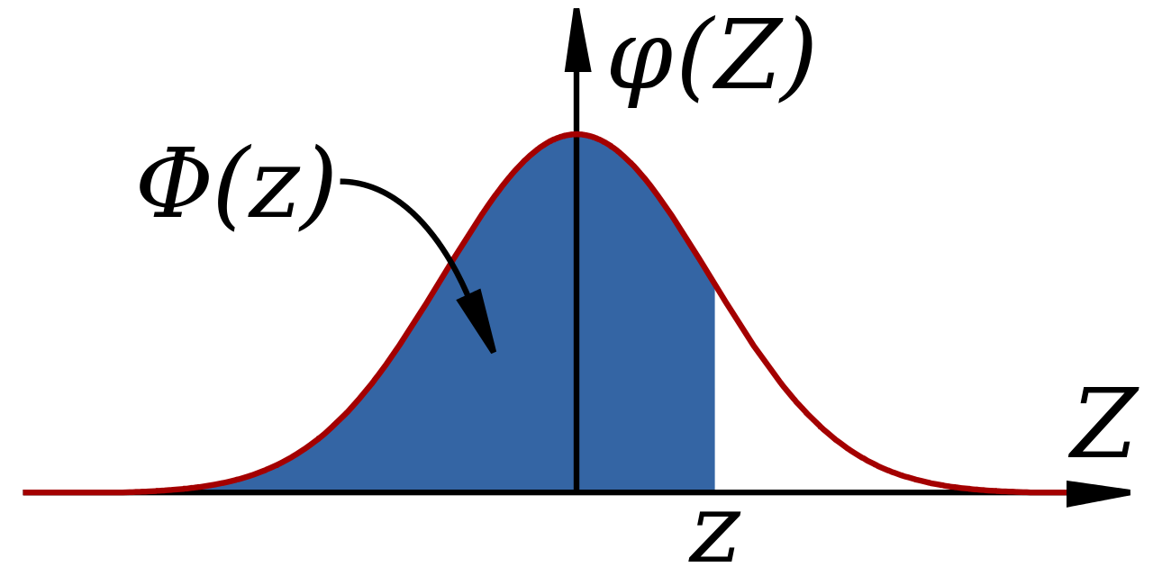
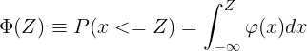
CUMULATIVE DISTRIBUTION FUNCTION: CDF
This function gives the probability to get ANY value below or equal to a given one ( confidence level = 1- α ) (significance level = α ) for a given distribution.
1- α
α

Slide 72

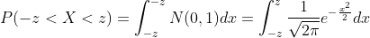
COMPUTING PROBABILITIES FOR THE NORMAL
Given a normal distribution, we can also be interested in knowing how big or small can be a value for which we have a given amount of probability.
Use the symmetry of the distribution in your favor.

Slide 73
STATISTICAL TESTS TYPES:
The one sample statistical tests can be broadly classified into:
One tailed test
Two tailed test
One-tailed hypothesis tests are also known as directional and one-sided tests because you can test for effects in only one direction
Two-tailed hypothesis tests are also known as nondirectional and two-sided tests because you can test for effects in both directions.

Slide 74
STATISTICAL TESTS SAMPLE SIZE:
If the sample size is smaller than 30: use the t-Student distribution with setting number of degrees of freedom = sample_size - 1
Otherwise you can safely use the normal distribution.
Both distributions are symmetric around the center 0.
The t-Student distribution is more spiked at the center and it has longer tails.
When the sample_size is large, both distributions are almost identical.

Slide 75
ONE SAMPLE ONE TAILED TEST:
How big can be a value in order to a given amount of probability to get any value smaller or equal to it for a normal distribution?
1- α
α

Slide 76
BIGGER SAMPLE SIZE: ONE SAMPLE, ONE TAILED TEST
Boys of a certain age are known to have a mean weight of μ = 85 pounds.
A complaint is made that the boys living in a municipal children's home are underfeed. (μ < 85 pounds)
A sample of n = 50 boys (of the same age) are weighed and found to have a sample mean weight of 80.94 pounds.
It is known that the population standard deviation σ is 11.6 pounds
Based on the available data, what should be concluded concerning the complaint?

Slide 77
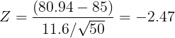
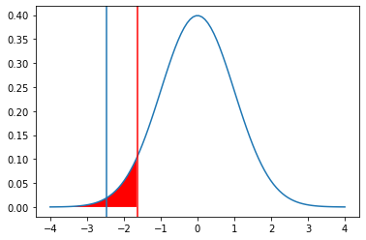
EXAMPLE: ONE SAMPLE, ONE TAILED TEST
In our case:
Where is located the critical value of the normal distribution with an area of 0.95? -> zc = 1.64
zc = +- scipy.stats.norm.ppf(0.95)
Our z = -2.47 < - 1.64 = zc -> reject null hypothesis
Children are underfeed.

Slide 78
EXAMPLE: ONE SAMPLE, ONE TAILED TEST
Boys of a certain age are known to have a mean weight of μ = 85 pounds.
A complaint is made that the boys living in a municipal children's home are underfeed. (μ < 85 pounds)
A sample of n = 25 boys (of the same age) are weighed and found to have a sample mean weight of 80.94 pounds.
It is known that the population standard deviation σ is 11.6 pounds
Based on the sample, can we say that the boys have a mean weight smaller than 85 pounds?
Our sampling error is (80.94 - 85) = -4.06 pounds. How likely is to get this value?

Slide 79
EXAMPLE: ONE SAMPLE, ONE SIDED TEST
What are we trying to establish here?
Contrast (provide enough evidence) the null Hypothesis H0: μ = 85 pounds.
However, we do not have the complete data from the population.
Therefore, we take a SAMPLE of 25 subjects < 30.
Small sample sizes follow a t-student distribution with n - 1 degrees of freedom
The number of degrees of freedom บ is: n - 1 (sample size - 1, 24 in this case)
So based on this sample data we will try to prove or disprove our Hypothesis, using a statistical test.

Slide 80
EXAMPLE: ONE SAMPLE, ONE SIDED TEST
Steps for solving this problem:
Step1: Define the null hypothesis - This is our assumption about the population. It is defined by H0 and in this case H0: μ = 85
Step 2: Define the alternative hypothesis- This means, what if our assumption is not true, inf fact the value is smaller.. It is defined by Ha and in this case Ha: μ < 85

Slide 81
EXAMPLE: ONE SAMPLE, TWO TAILED TEST
Boys of a certain age are known to have a mean weight of μ = 85 pounds.
A complaint is made that the boys living in a municipal children's home are underfeed or obese. (μ != 85 pounds)
A sample of n = 50 boys (of the same age) are weighed and found to have a sample mean weight of 80.94 pounds.
It is known that the population standard deviation σ is 11.6 pounds
Based on the available data, what should be concluded concerning the complaint?

Slide 82
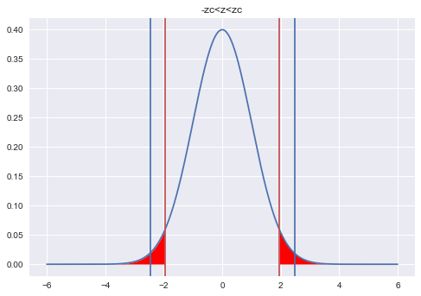
EXAMPLE: ONE SAMPLE, TWO SIDED TEST
In our case:
Where is located the critical value of the normal distribution with an area of 0.95? -> zc = 1.96
zc = +-scipy.stats.norm.ppf(1-(0.05/2)=0.975)
Now Zc = -1.96 > Z= - 2.47 -> reject null hypothesis
Children don’t have the mentioned weight.

Slide 83
EXAMPLE: ONE SAMPLE, ONE SIDED TEST
Since in this case, our null hypothesis would be false on either side of Ha, hence such a test is called a One sided Test, ie Ha: μ < 85, H0 is false
Step 3: Decide a test statistic based on the information available. As the sample size is small ( n < 30 ), we will use a statistic for a t-Student distribution.
Step 4: Set the Confidence level / significance level: This defines the rejection region / critical region (How strong has to be the evidence against the null hypothesis). Significance level is defined by greek letter ‘α’. Usual values for confidence level are ( 90%, 95%, 99%) -> significance levels = (0.10, 0.05, 0.01). Let’s use a confidence level of 95% -> α = 0.05

Slide 84
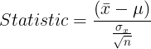
EXAMPLE: ONE SAMPLE, ONE SIDED TEST
Step 5: Calculate the test statistic based on the given information:
Yes
No
If you don’t have the population standard deviation, use the corrected sample standard deviation
Is the statistic within the
acceptable region?
Accept Ho (null hypothesis)
Reject Ho (null hypothesis)

Slide 85
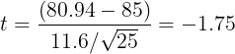
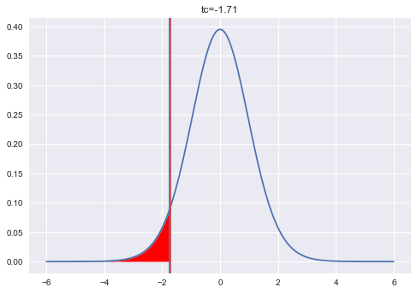
EXAMPLE: ONE SAMPLE, ONE SIDED TEST
In our case:
Where is located the critical value of the t-student distribution with 24 degrees of freedom and an area of 0.95? -> tc = 1.71
tc = +- scipy.stats.t.ppf(0.95, df=24)
Our t = -1.75 < - 1.71=tc-> reject null hypothesis
Children are underfeed.
Unshaded area = 0.95

Slide 86
EXAMPLE: ONE SAMPLE, TWO TAILED TEST
Boys of a certain age are known to have a mean weight of μ = 85 pounds.
A complaint is made that the boys living in a municipal children's home have a different average weight. (μ != 85 pounds)
A sample of n = 25 boys (of the same age) are weighed and found to have a sample mean weight of 80.94 pounds.
It is known that the population standard deviation σ is 11.6 pounds
Based on the available data, what should be concluded concerning the complaint?

Slide 87
ONE SAMPLE, TWO TAILED TEST
Two-tailed test is a method to tests whether a sample is greater than or less than a certain range of values.
Ex:
Null Hypothesis: Ho -> μ = 85 pounds
Alternate hypothesis: Ha -> μ != 85 pounds

Slide 88
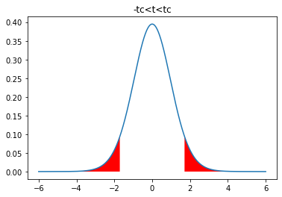
EXAMPLE: TWO SIDED TEST
Acceptance
region
Now, our value can be bigger or smaller than the population value. Therefore, the “rejection region” has to be shared at both sides!
α/2
1-α
α/2
Where are the vertical bars located?

Slide 89
EXAMPLE: ONE SAMPLE, TWO SIDED TEST
Step 5: Calculate the test statistic based on the given information:
Yes
No
If you don’t have the population standard deviation, use the corrected sample standard deviation
Is the statistic within the
acceptable region?
Accept Ho (null hypothesis)
Reject Ho (null hypothesis)

Slide 90
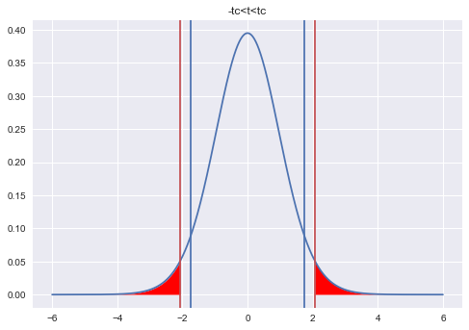
EXAMPLE: ONE SAMPLE, TWO SIDED TEST
In our case:
Where is located the critical value of the t-student distribution with 24 degrees of freedom and an area of 0.95? -> tc = 2.06
tc = +-scipy.stats.t.ppf(1-(0.05/2)=0.975,df=24)
Now, tc = -2.06 < -1.75 = t-> accept null hypothesis
Children have the mentioned average weight.

Slide 91
Two sample t-test.
DATA ANALYTICS | IRONHACK

Slide 92
IRONHACK BOOTCAMP
TWO SAMPLE T-TEST
What happens if we want to determine up to which extent the sample means of two different populations are the same?
Here instead of drawing an inference on two populations through its sample data, we try to compare the means of two sample populations from which two different populations are drawn. It helps us to test whether the population means of the two groups are equal or not.

Slide 93
IRONHACK BOOTCAMP
TWO SAMPLE T-TEST
Two samples, two populations.
Population A
Population B
Sample from A
Sample from B

Slide 94
IRONHACK BOOTCAMP
TWO SAMPLE T-TEST
What happens if we want to determine up to which extent the means of two sample populations are the same?
Here instead of drawing an inference on one population through its sample data, we try to compare the means of two sample populations from which two different sample sets are drawn. It helps us to test whether the population means of the two groups are equal or not.

Slide 95
IRONHACK BOOTCAMP
TWO SAMPLE T-TEST
Some of the assumptions on the data before we can use this test are:
Populations from which the samples are drawn is assumed to be normally distributed
Sample data has continuous values and not discrete
Random samples must be drawn from the populations
Data in the two samples must be independent of each other

Slide 96
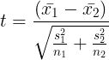
IRONHACK BOOTCAMP
TWO SAMPLE T-TEST: DOING THE CALCULATIONS
We need to compute our statistic, that is based on the difference between the sample means:
If:
min(n1,n2) < 30 use the t-Student distribution
use the normal distribution
Use a two sided test.

Slide 97
IRONHACK BOOTCAMP
USE CASE EXAMPLE
A psychologist was interested in exploring whether or not male and female college students have different driving behaviors.
There were a number of ways that she could quantify driving behaviors. She opted to focus on the fastest speed ever driven by an individual. Therefore, the particular statistical question she framed was as follows
Is the mean fastest speed driven by male college students different than the mean fastest speed driven by female college students?
She conducted a survey of a random n = 34 male college students and a random m = 29 female college students. Here is a descriptive summary of the results of her survey:
Males: sample size = 34 Sample mean = 105.5 Sample standard deviation: 20.1
Females: sample size = 29 Sample mean = 90.0 Sample standard deviation:12.2

Slide 98
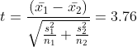
IRONHACK BOOTCAMP
USE CASE EXAMPLE
tc = stats.scipy.t.ppf(1-(0.05/2),df) = 2.05
T = 3.76 > 2.05 = tc -> Reject the null hypothesis.

Slide 99


